Slide 1
Week 2 Updates Shapiro
By Evan Johns

Slide 2
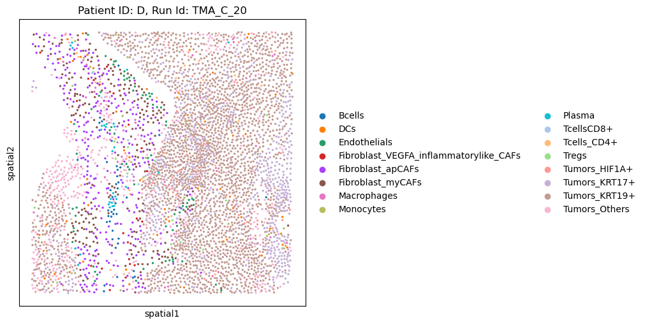
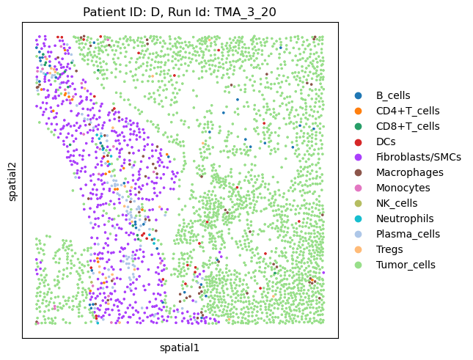
Mapping Protein to mRNA
mRNA
Protein
Updated to match RNA with the protein slides. Had to flip the Y coordinates so that they match
Matches are not 1-1 as expected and some are better than others.
Note the patient IDs in the metadata do not align
Week 2 Updates

Slide 3
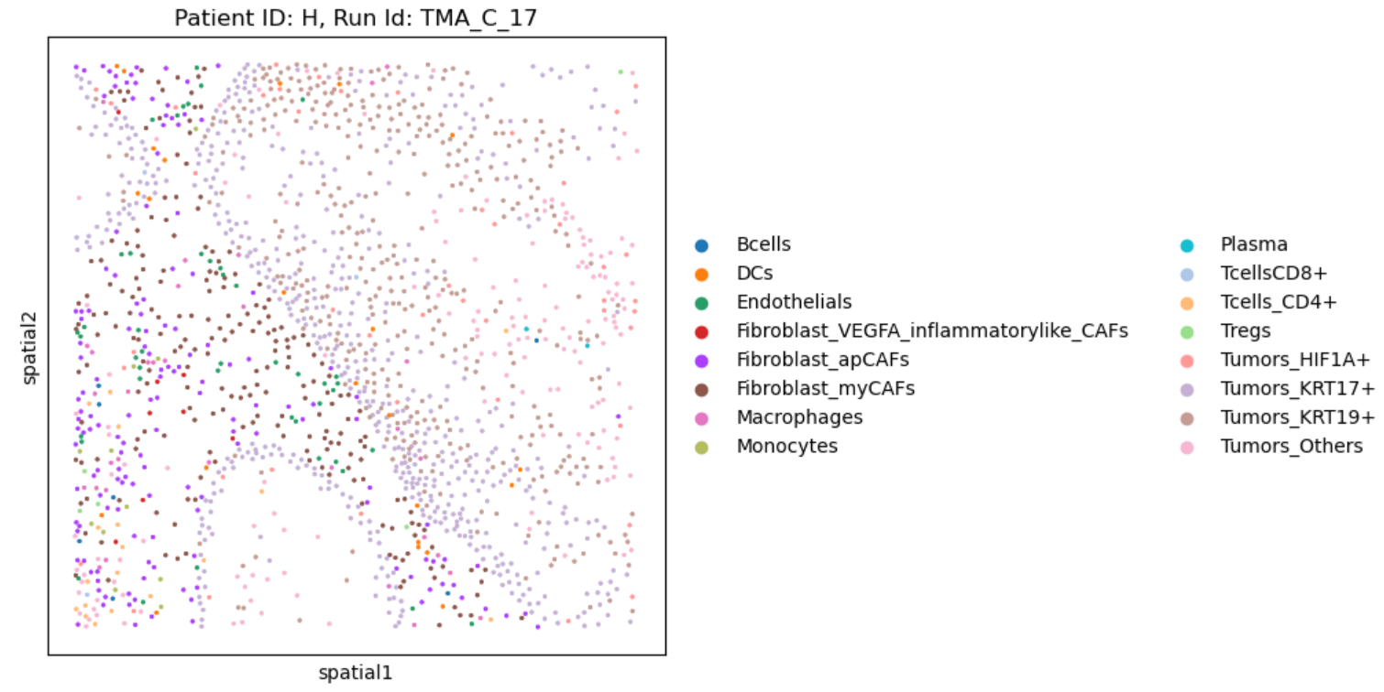
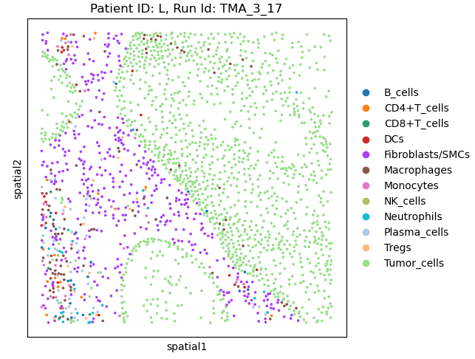
Mismatching Patient IDs between mRNA and Protein
Mismatching patient IDs H & L for the sample tissue sample. May cause issues analyzing the response status. Response status only listed in the RNA metadata

Slide 4
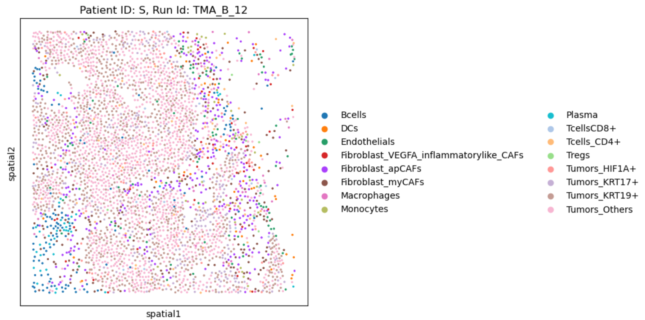
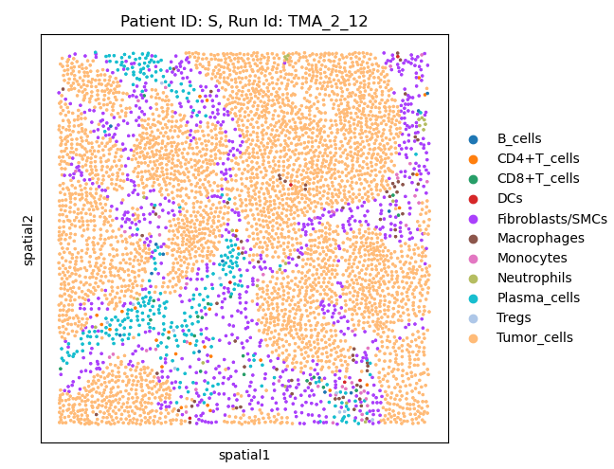
Some matches are poor
Most matches are recognizable, but some may be very difficult to map.
Recommend only trying to map a subset of the data.

Slide 5
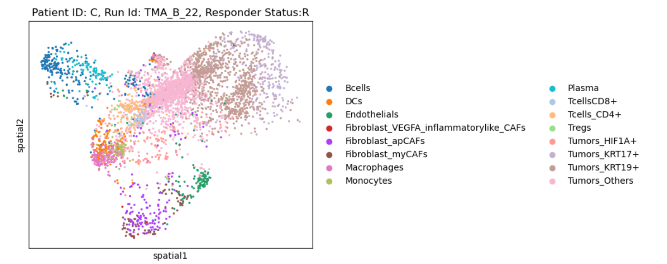
Umap Mappings for Cell Types in Python

Slide 6
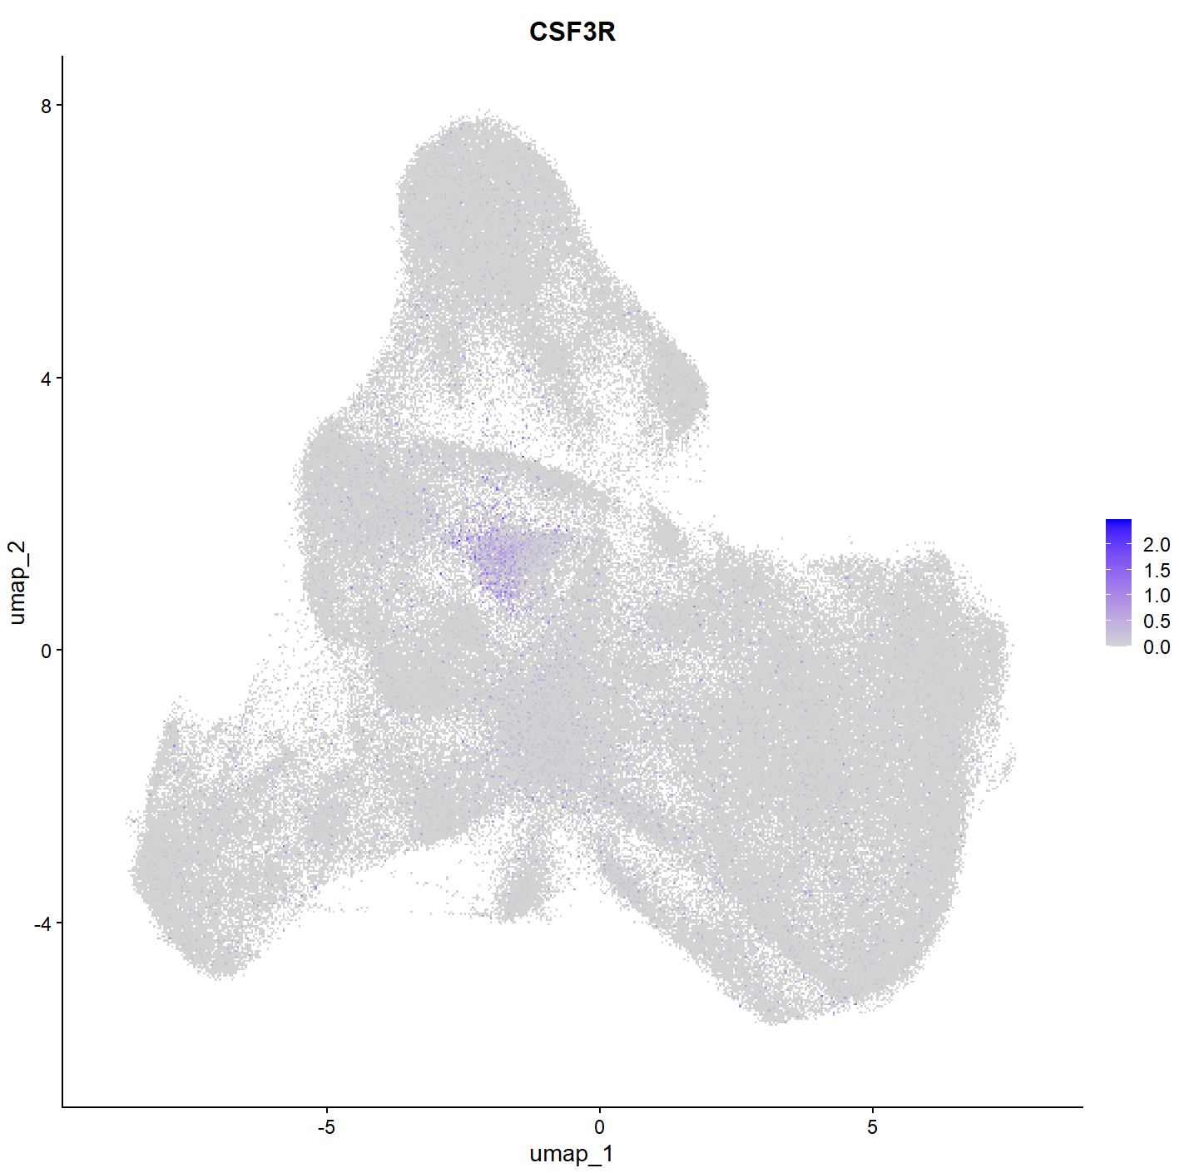
CSF3R Gene
Possible marker for PMN
Only expressed in small portion of cells. Not currently well definined
Future direction
Can we isolate cells with low overall expression and higher CSF3R expression
Other gene markers such as S100A8 and S100A9 may also be helpful

Slide 7
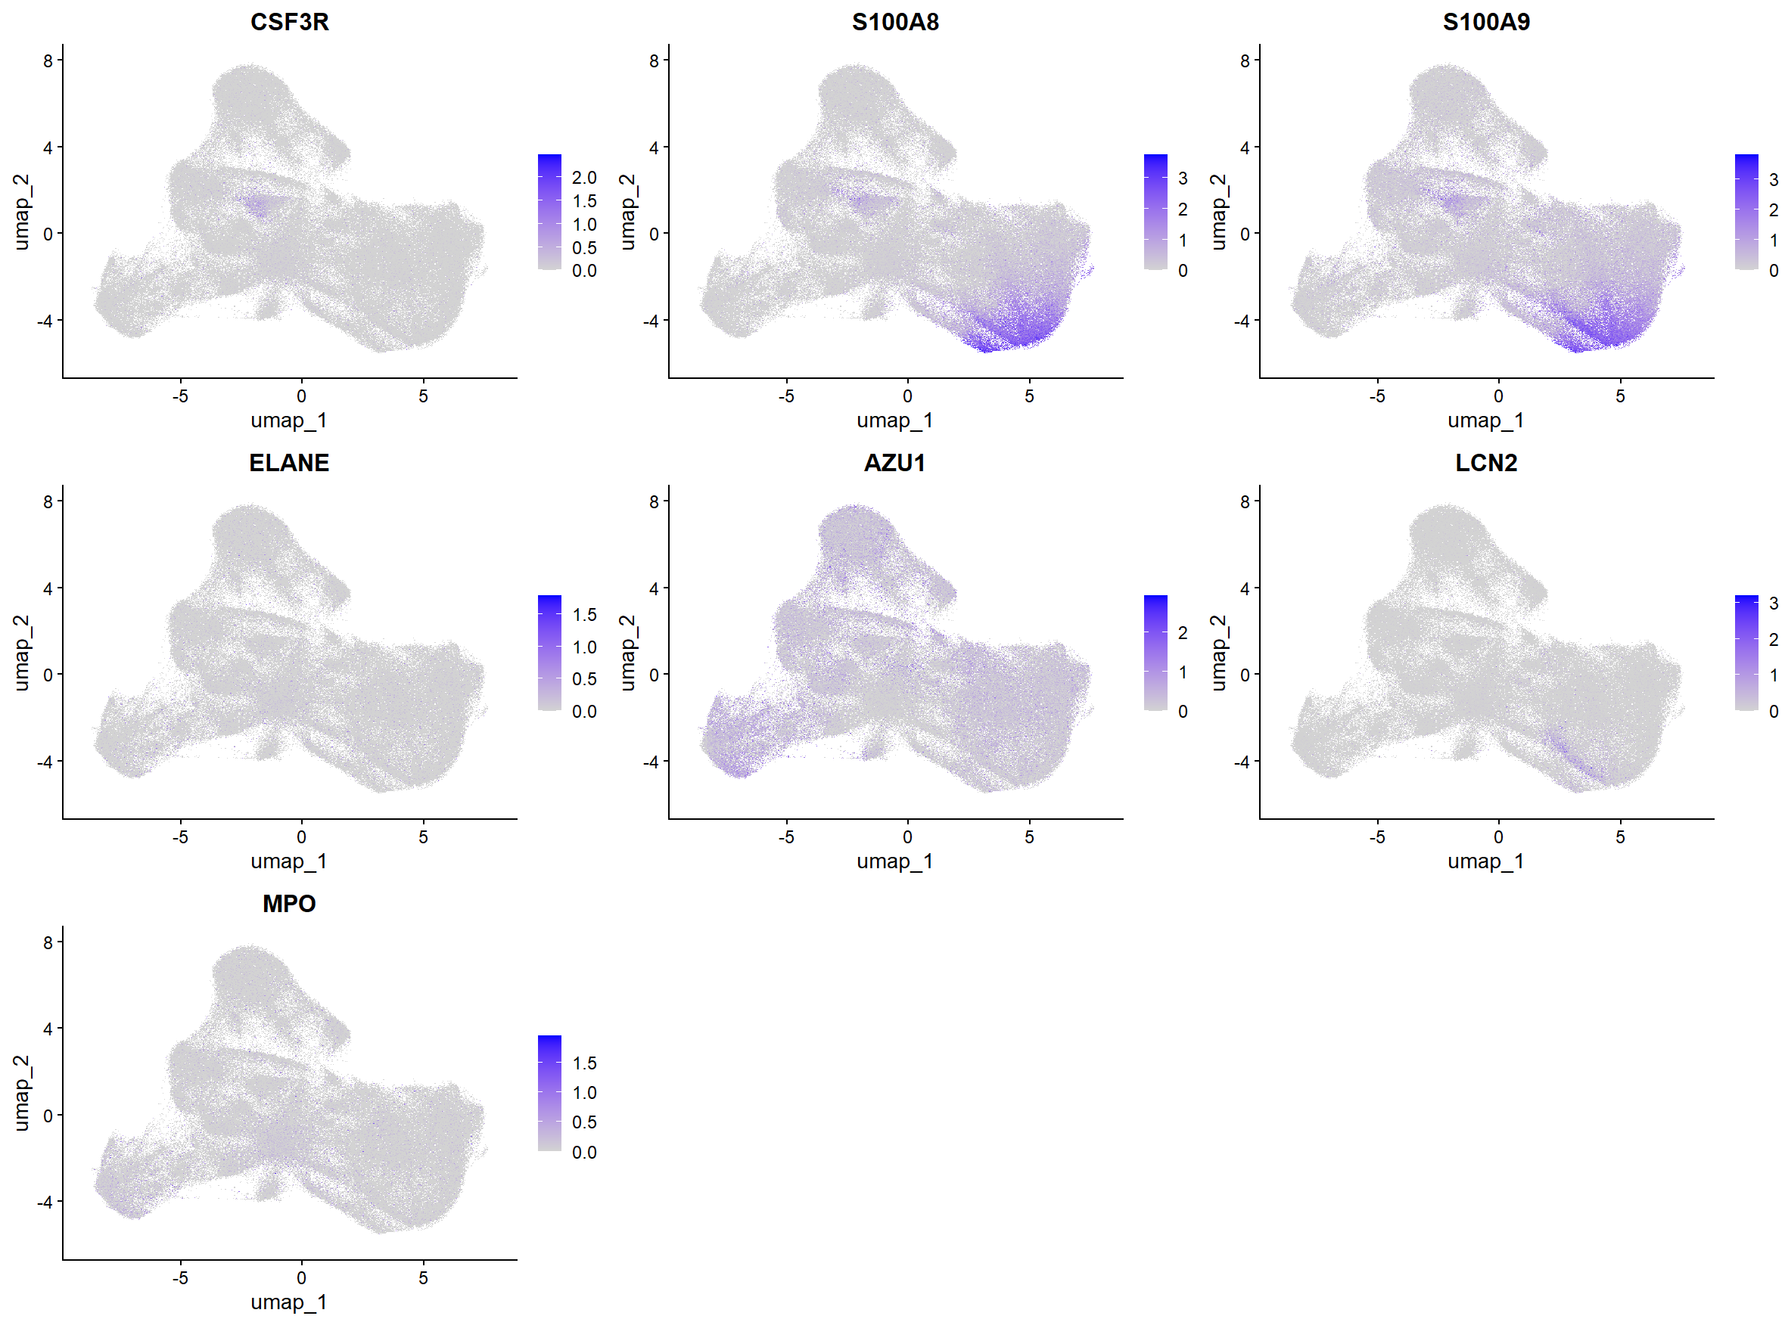
Other Genes

Slide 8
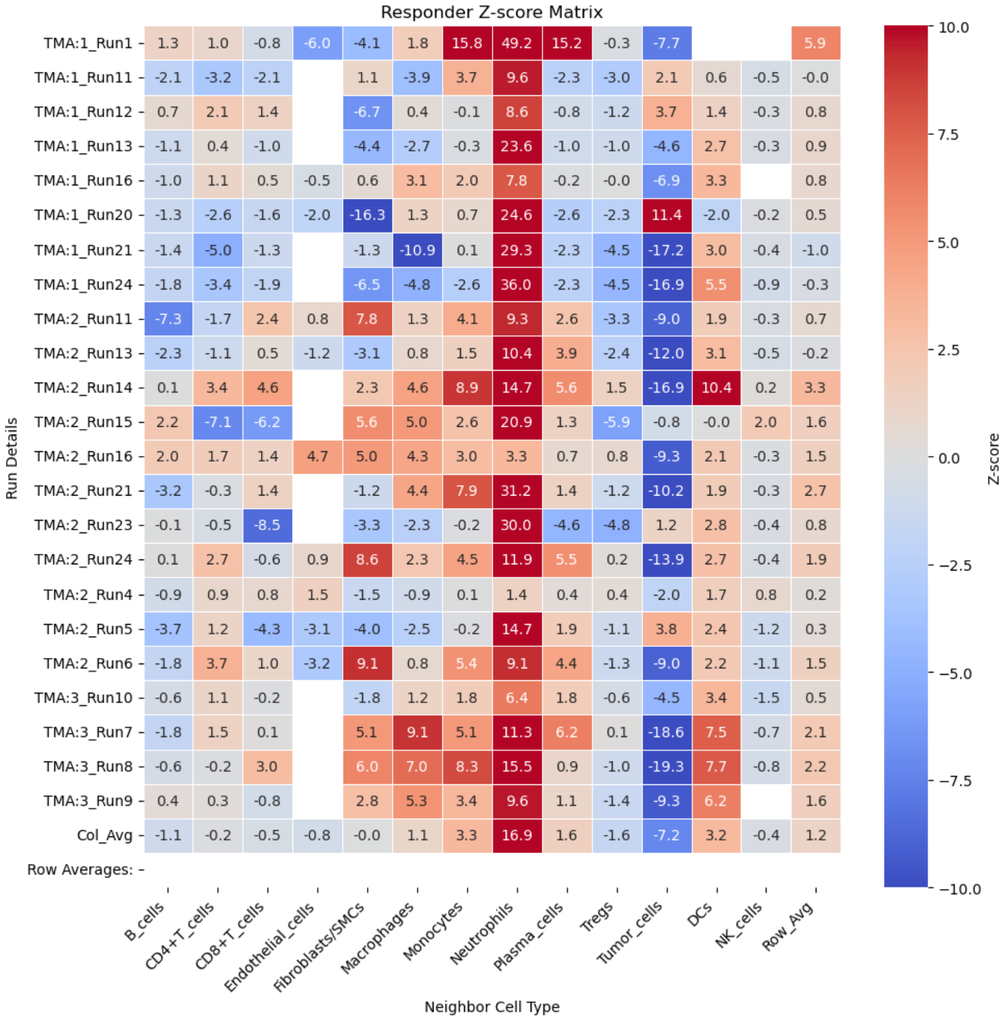
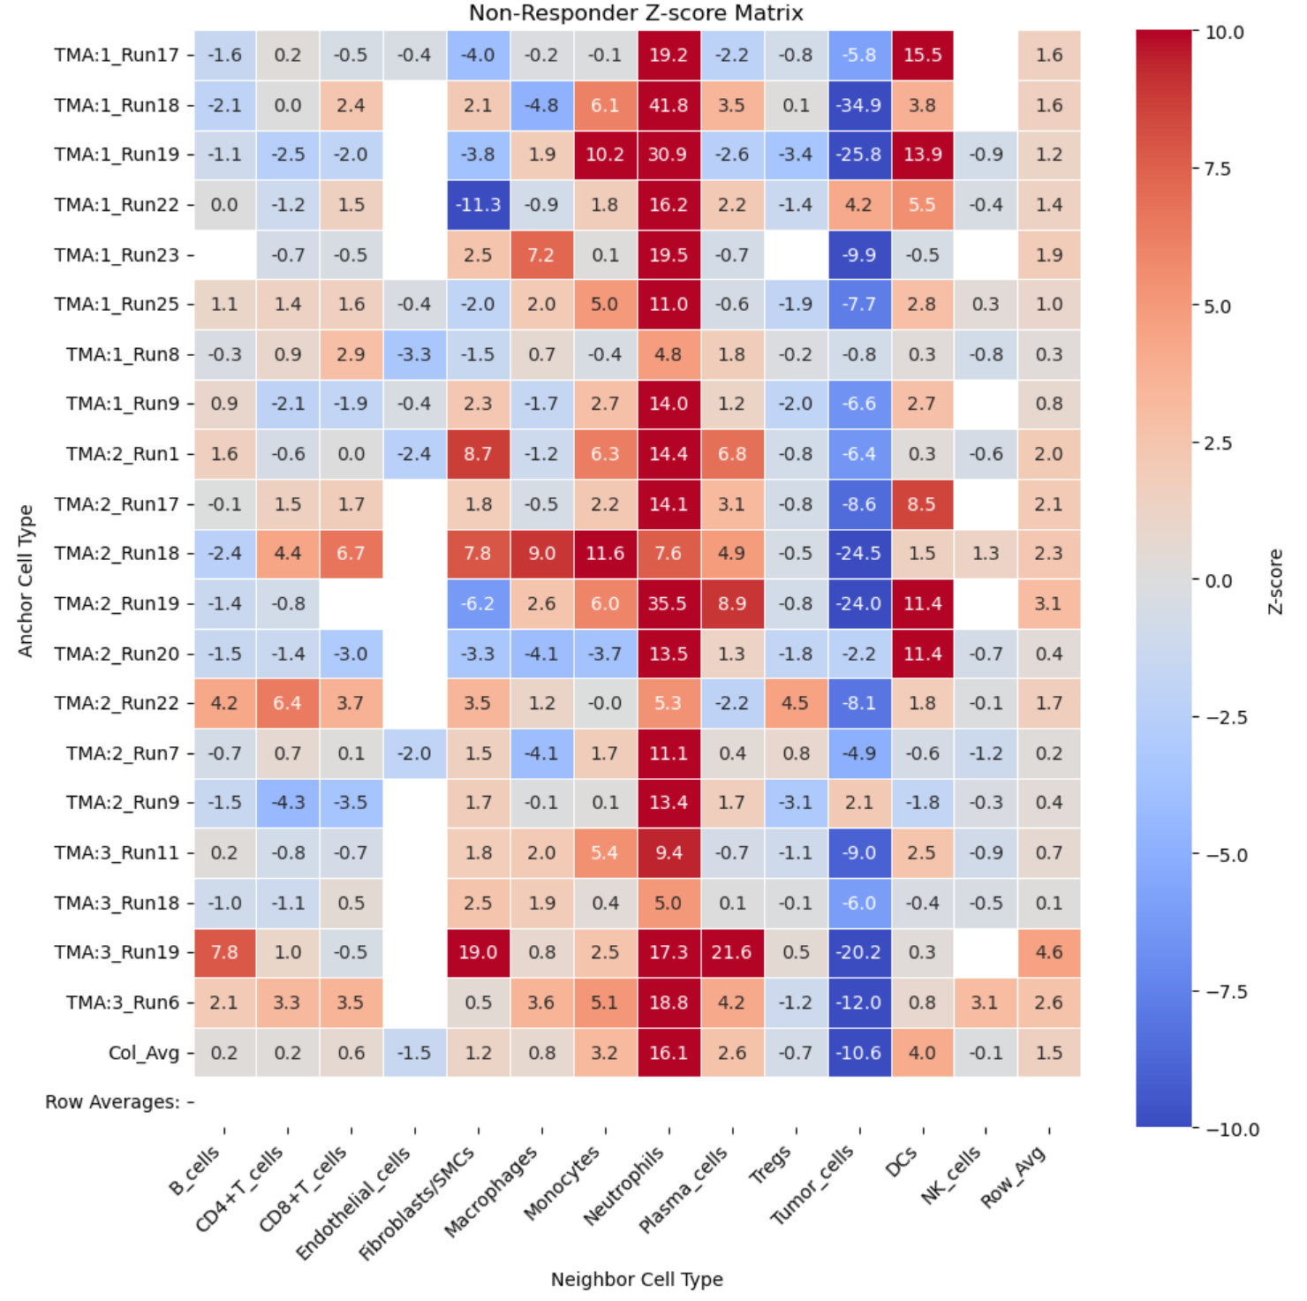
Protein Colocalization Analysis

Slide 9
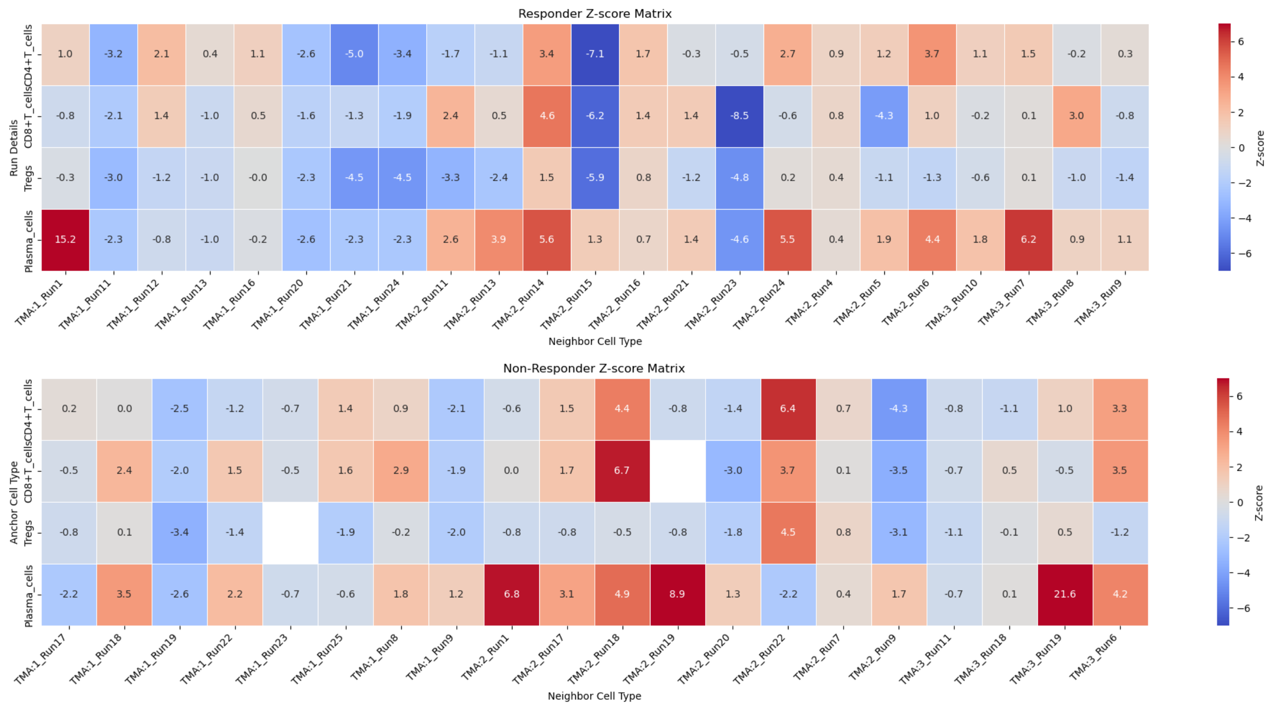
Protein Colocalization Analysis

